Slide 1
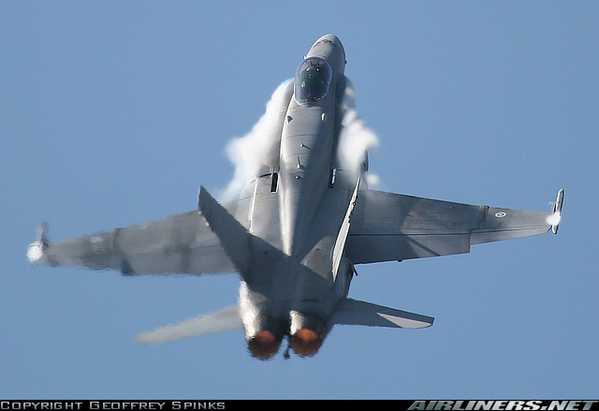
Chapter III. Maneuvering performance
Notes:
III- <number>
Issue 1 – Feb 2011
III – Maneuvering performance
In the first sections, in straight flight and in climb or descent (at low climb/descent angles), lift balances weight.
When lift and weight are not balanced, a normal acceleration develops, leading to a curvature of aircraft trajectory in the vertical plane (pull-up or push-over) or in the horizontal plane.
To deal with maneuvering performance, forces equation must be written in the general case. For this purpose, flight mechanics reference systems must be defined, as well as the notion of load factor.
Lift and propulsion equations allow to define normal load factor limitations, to study maneuvering performance.
The end of this section is dedicated to low altitude flight envelope, where compressibility effects may be neglected (except for supersonic fighters which are able to fly at supersonic speeds at low altitude) and high altitude flight envelope.
Illustration : Boeing F/A-18 « Hornet » in a pull-up maneuver. At high angles of attack, wing apexes generate vortices which are materialized here by condensation.

Slide 2
1. Lift and normal acceleration
Lift is controlled through attitude changes
Steady flight
ΔZ
Δγ_{a}
Δα = Δθ
ΔF
ΔZ_{T}
Pitch attitude is increased by an elevator input.
As a consequence, angle of attack increases and lift becomes higher than weight. trajectory is curved upwards.
Positive climb : at constant
pitch attitude angle of attack decreases.
If thrust is increased to maintain initial speed, angle of attack returns to its initial value.
Notes:
The pilot controls the airplane attitude. Its control over lift is not direct since lift is a function of angle of attack and airspeed.
The above figure illustrates this through the principle of transition from horizontal flight to climb :
The airplane is initially in straight steady horizontal flight : lift balances weight and thrust balances drag.
A nose-up elevator input is applied to increase pitch attitude (the consequence of negative lift increment on the horizontal tailplane is a positive pitching moment increment).
Due to increased pitch attitude, the angle of attack increases producing a positive lift increment. Lift exceeds weight, the result being an upwards normal acceleration : climb angle increases.
Pitch attitude is stabilized. At constant pitch attitude, when climb angle increases, angle of attack decreases. When angle of attack, and thus lift, return to their initial values, the trajectory stabilizes at constant climb angle. However, to maintain constant speed, thrust must be increased to balance the weight component parallel to speed.

Slide 3
2. Flight mechanics reference systems
Airplane and earth reference system
x₁
φ₁
y₀
y_{ψ}
θ
θ
ψ
x_{ψ}
ψ
φ₁
x₀
G
0° ≤ ψ ≤ 360°
-90° ≤ θ ≤ 90°
-180° ≤ φ₁ ≤ 180°
y₁
ψ
ψ azimuth angle
θ pitch attitude
φ₁ bank angle
z₁
z₀
Notes:
The transfer from earth reference system Gx₀y₀z₀ to airplane reference system Gx₁y₁z₁ is performed through three rotations undertaken in the following order :
The first rotation, angle ψ around Gz₀, defines Gx_{ψ}y_{ψ}z₀.
The second rotation, angle θ around Gy_{ψ}, defines Gx₁y_{ψ}z_{θ}, (Gz_{θ}, axis is not shown on the above figure for better visibility).
After the third rotation, angle φ₁ around Gx₁, we obtain the airplane reference system Gx₁y₁z₁.
Notes :
Despite similar notations, the three rotation angles ψ, θ and φ₁ are different from Euler angles (usually noted ψ, θ and φ).
Reversing the order of the last 2 rotations we may define three other angles noted ψ₁, θ₁ and φ for the transfer from Gx₀y₀z₀ to Gx₁y₁z₁.
The main difference between ψ₁, θ₁ and φ and ψ, θ, φ₁ is that φ (roll attitude) is the angle between Gy₁ axis and the horizontal plane (Gx₀y₀) and may vary between - 90° and + 90°, while θ₁ may vary between -180° and + 180° (see slide N°11).
Termes français : ψ est l’azimut, θ est l’assiette longitudinale et φ₁ est l’angle de gîte, ψ₁ est l’azimut transversal, θ₁ est l’angle de tangage et φ est l’assiette latérale.

Slide 4
2. Flight mechanics reference systems
Airplane and earth reference system
x₁
θ
Horizontal plane
y₀
x_{ψ}
ψ
x₀
G
Airplane heading and attitude are defined by ψ, θ and φ₁.
Pitch attitude θ is the angle between Gx₁ axis and the horizontal plane.
Azimuth angle ψ is the angle between Gx₀ and Gx_{ψ} (projection of Gx₀ in the horizontal plane).
Notes:
The transfer matrix between airplane reference system and earth reference systems is defined as follows :
[X₁] = [M₁₀] [X₀]
[X₀] are vector coordinates in earth reference system
[X₁] are vector coordinates in airplane reference system
[M₁₀] is the transfer matrix ([M₀₁] = [M₁₀] ⁻¹ = [M₁₀] ^{t})
The transfer matrix [M₁₀] elements are functions of ψ, θ and φ₁ :
cosψ cosθ sinψ cosθ - sinθ
-sinψ cosφ₁ + cosψ sinθ sinφ₁ sinψ sinθ sinφ₁ + cosψ cosφ₁ cosθ sinφ₁
sinψ sinφ₁ + cosψ sinθ cosφ₁ sinψ sinθ cosφ₁ - cosψ sinφ₁ cosθ cosφ₁

Slide 5
2. Flight mechanics reference systems
Attitude and heading indications
φ₁ = - 45°
θ = 7.5°
20
Attitude
A/C reference
10
20
y₁
-10
10
Horizon line
-10
z₀
y₀
z₁
Heading
ψ = 180°
16
17
18
19
20
Notes:
The pilot (human or autopilot) must have heading and attitude information to control the airplane. A human pilot may use external cues (horizon, landmarks) in good conditions. But in instrument conditions, it must rely on information from horizontal horizon and from the heading indicator.
The artificial horizon presents the airplane attitude relative to the earth : pitch attitude and bank angle.
The center of the artificial horizon represents the A/C reference.
Note : In this case, the bank angle (φ₁) is negative, since the airplane is banked to the left.
The artificial horizon may be an independent gyroscopic instrument or may be part of an integrated instrument such as a PFD (« Primary Flight Display ») which presents information from an inertial reference system.
The heading indicator presents the airplane orientation relative to the horizontal plane (usually relative to magnetic North).

Slide 6
2. Flight mechanics reference systems
Aerodynamic reference system
G
x₁
α
y
β
→
V
β
x₂
y₁
x
α angle of attack
β sideslip angle
z
α
z₁
→
-180° ≤ α ≤ 180°
-90° ≤ β ≤ 90°
Gx is parallel to the air velocity vector (V)
Notes:
The aerodynamic reference system is defined by rotating the airplane reference system in order to align Gx with the aerodynamic velocity vector.
In aerodynamic reference system, the coordinates of the aerodynamic velocity vector are :
The aerodynamic reference system is used for performance studies since :
aerodynamic forces are well defined in this system,
acceleration vector component along Gx axis is the tangential acceleration.
Termes français : Gxyz est le trièdre aérodynamique, Gx₂y₁z est le trièdre intermédiaire, α est l’incidence et β le dérapage.

Slide 7
2. Flight mechanics reference systems
Airplane and aerodynamic reference systems
Aircraft symmetry plane Gx₁z₁
G
x₁
α
β
x₂
z₁
x
Sideslip angle β is the angle between Gx axis and the aircraft symmetry plane.
From Gx₁y₁z₁ to Gxyz :
  Angle α rotation around Gy₀ : Gx₂y₀z, then,
  Angle β rotation around Gz₁: Gxyz.
Notes:
The transfer matrix between airplane reference system and aerodynamic reference system is defined as follows :
[X] = [M_{A1}] [X₁]
[X] are vector coordinates in aerodynamic reference system
[X₁] are vector coordinates in airplane reference system
[M_{A1}] is the transfer matrix ([M_{1A}] = [M_{A1}] ⁻¹ = [M_{A1}] ^{t})
The transfer matrix [M_{A1}] elements are functions of α and β :
cosα cosβ sinβ sinα cosβ
- cosα sinβ cosβ - sinα sinβ
- sinα 0 cosα

Slide 8
2. Flight mechanics reference systems
Aerodynamic and earth reference systems
x
μ
y₀
γ_{a}
y_{χ}
γ_{a}
χ
x_{χ}
→
V
χ
μ
x₀
G
y
χ
0° ≤ χ ≤ 360°
-90° ≤ γ_{a} ≤ 90°
-180° ≤ μ ≤ 180°
χ aerodynamic azimuth
γ_{a} aerodynamic flight path angle
μ aerodynamic bank angle
z
z₀
Notes:
While ψ, θ and φ₁ define the airplane attitude, χ, γ_{a} and μ are related to the airplane trajectory (relative to the air).
The vertical speed component relative to the air (rate of climb) is :
Vz = V sinγ_{a}
It may be shown that at zero sideslip (β = 0), the aerodynamic bank angle μ equals the roll attitude φ (in normal flight) :
β = 0 μ = φ or μ = - φ (inverted flight)
Termes français : χ est l’azimut aérodynamique, γ_{a} la pente aérodynamique (ou pente-air) et μ l’angle de gîte aérodynamique, Vz est la vitesse ascensionnelle (par rapport à l’air) ou taux de montée.

Slide 9
2. Flight mechanics reference systems
Aerodynamic, kinetic and earth reference systems
x
→
Horizontal plane
γ_{a}
V
y₀
x_{χ}
χ
x₀
G
The aerodynamic flight path angle γ_{a} is the angle between the air velocity vector and the horizontal plane.
The kinetic reference system Gx_{k}y_{k}z_{k} is similar to the aerodynamic reference system, Gx_{k} being parallel to the ground velocity vector.
  γ_{k} is the flight path angle relative to the ground, angle between the ground velocity vector and the horizontal plane.
Notes:
The transfer matrix between aerodynamic reference system and earth reference systems is defined as follows :
[X] = [M_{A0}] [X₀]
[X₀] are vector coordinates in earth reference system
[X] are vector coordinates in aerodynamic reference system
[M_{A0}] is the transfer matrix ([M_{A0}] = [M_{A0}] ⁻¹ = [M_{A0}] ^{t})
The transfer matrix [M_{A0}] elements are functions of χ, γ_{a} and μ :
cosχ cosγ_{a} sin χ cosγ_{a} - sinγ_{a}
-sin χ cos μ + cos χ sin γ_{a} sin μ sin χ sin γ_{a} sin μ + cos χ cos μ cos γ_{a} sin μ
sin χ sin μ + cos χ sin γ_{a} cos μ sin χ sin γ_{a} cos μ - cos χ sin μ cos γ_{a}cos μ
The vertical speed component relative to the ground (rate of climb) is :
Vz_{k} = Vk sinγ_{k}
Note : If the vertical wind is zero, the vertical speed components relative to the ground and relative to the air are equal.
Termes français : Gxkykzk est le trièdre cinématique, γ_{k} la pente cinématique (ou pente-sol).

Slide 10
2. Flight mechanics reference systems
0° ≤ ψ ≤ 360°
-90° ≤ θ ≤ 90°
-180° ≤ φ₁ ≤ 180°
Airplane reference system
Gx₁y₁z₁
x₁
y₁
G
ψ azimuth angle
θ pitch attitude
φ₁ bank angle
α angle of attack
β sideslip angle
z₁
-180° ≤ α ≤ 180°
-90° ≤ β ≤ 90°
Earth reference system
Gx₀y₀z₀
Aerodynamic reference system
Gxyz
x₀
y₀
x
y
G
G
z₀
z
0° ≤ χ ≤ 360°
-90° ≤ γ_{a} ≤ 90°
-180° ≤ μ ≤ 180°
χ aerodynamic azimuth
γ_{a} aerodynamic flight path angle
μ aerodynamic bank angle
Notes:
This figure shows the relationship between the three usual reference systems.
It is possible to express ψ, θ and φ₁ as functions of α, β, χ, γ_{a} and μ : performing two successive transfers from airplane reference system to aerodynamic reference system, then to earth reference system is equivalent to perform a direct transfer from airplane reference system to earth reference system.

Slide 11
3. Load factor
Flight mechanics equations
→
→
→
d
→
Forces
Ra
+
F
+
m
g
=
(mVk)
dt
Thrust levers
Aerodynamics
Propulsion
Weight
Inertia
→
→
→
→
Ma_{/G}
+
MF_{/G}
d
→
Moments
=
dt
( I . Ω_{k})
Flight controls
Notes:
The above expressions for flight mechanics equations apply to aircraft in flight : on ground, during take-off and landing, ground reactions must be added.

Slide 12
3. Load factor
Load factor components
Airplane reference system
n_{x1}, n_{y1}, n_{z1} ⇒ Structural loads
Aerodynamic reference system
n_{x}, n_{y}, n_{z} ⇒ A/C trajectory
Notes:
Accelerometers fixed to airplane structure measure the load factor components in the airplane reference system (this is true if they are located at the airplane center of gravity, otherwise they need to be corrected for rotation).
Load factor components in aerodynamic reference system may be expressed as functions of load factor components in airplane reference system, using transfer matrix :

Slide 13
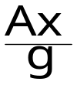
3. Load factor
Gravity and acceleration : example of acceleration at take-off
Ax
x₁
x₁
x₀
- g sinθ
θ
x₀
g
g
g cosθ
z₁
z₀
Ground roll
n_{z1} = 1
n_{x1} = -
Flight simulator
n_{z1} = cosθ
n_{x1} = - sinθ
z₀
z₁
The human pilot « feels » load factor components. Without visual cues he is not able to differentiate gravity from acceleration.
Notes:
This example illustrates the fact that, without visual or instrument cues, it is not possible to differentiate gravity from acceleration in the load factor components.
It must be noticed that the human body has its own sensors (accelerometers and gyrometers) located in the vestibular system (part of the internal ear). Those sensors provide some « feeling » for accelerations and angular rotations. It must be stressed that those sensors are adapted for walking and running and not for flying : they are partly responsible for motion sickness and spatial disorientation.

Slide 14
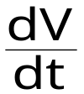

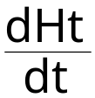
3. Load factor
Load factor components : constant wind hypothesis
V
x
- g sinγ_{a}
Ax
γ_{a}
x₀
Tangential acceleration :
Ax =
g
g cosγ_{a}
z₀
z
Longitudinal load factor component : n_{x} = - sin γ_{a} -
Zero wind hypothesis : = - n_{x} V
Notes:
The constant wind hypothesis is retained unless otherwise stated :
Note : The consequences of wind gradients are examined in a section of this course dedicated to the consequences of atmospheric phenomena on aircraft performance.
Total vertical speed is the time derivative of total height :
Under zero wind hypothesis :
Assuming that g ≅ g₀ :

Slide 15
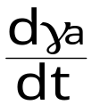

3. Load factor
Load factor components, constant wind hypothesis
Symmetrical pull-ups or pushovers (φ₁ = β = 0)
Az
V
x
- g sinγ_{a}
γ_{a}
x₀
Normal acceleration ( μ = 0) :
Az = - V
g
g cosγ_{a}
z₀
z
Normal load factor component :
n_{z} = cos γ_{a} +
Notes:
Assuming constant wind, general expressions for n_{y} and n_{z} are :
Wings leveled (φ₁ = 0), under zero sideslip (β = 0), μ equals zero :
Notes :
In straight flight (constant flight path angle) : n_{z} = cosγ_{a}
If the airplane is initially climbing and the flight path angle is then reduced continuously (negative curvature) it is possible to obtain zero « g » for significant periods of time (exceeding 30 seconds).
In inverted flight, wings leveled, under zero sideslip, φ₁ = μ = π, and the expression for normal load factor component is :

Slide 16

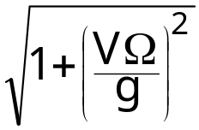
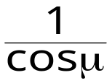
3. Load factor
Load factor components, constant wind hypothesis
Symmetrical turn in horizontal flight (β = γ_{a} = 0)
Aerodynamicbank angle
μ
Centripetal acceleration :
Ac = VΩ = V
Ω is the turn rate
Ac
- Ac
Normal load factor component :
n_{z} = =
n_{z} g
g
Notes:
Symmetrical turn means zero lateral load factor (n_{y} = 0).
From the expressions for load factor components under constant wind, we may write :
In symmetrical flight (n_{y} =0) :
In level flight (γ_{a} = 0), we obtain the expressions written on the slide.
Note : The term « Symmetrical flight » may correspond to three distinct notions : zero sideslip (β = 0) , zero lateral load factor in aerodynamic axes (n_{y} = 0) or zero lateral load factor in airplane reference system (n_{y1} = 0). In the absence of dissymmetry, those three notions are equivalent in straight flight. In « symmetrical turn » as shown on the slide : zero n_{y}, β and n_{y1} are not strictly zero, but they are usually small and those three notions may be considered as approximately equivalent : that is why some sideslip indicators rely on lateral load factor measurement (when the « ball » is centered ny₁ is zero). Those three notions are no longer equivalent when there is some asymmetry : loading asymmetry such as fuel unbalance, aerodynamic asymmetry or propulsion asymmetry.

Slide 17
3. Load factor
Forces equation projection in
aerodynamic reference system
→
→
→
Forces equation
Ra
+
F
+
mg n
=
0
Components in aerodynamic reference system
- ½ρV²SCx
½ρV²SCy
- ½ρV²SCz
F_{x}
F_{y}
- F_{z}
n_{x}
n_{y}
n_{z}
→
→
→
Ra
F
n
Notes:
In the above expressions, some signs are changed for practical reasons :
Drag is always negative in aerodynamic reference system (opposed to the velocity vector), while drag coefficient is defined as a positive number.
A positive lift coefficient corresponds to an upwards lift, while the aerodynamic axis Gz is oriented downwards.
For homogeneity with lift, the normal thrust component Fz is positive when it is similar to a positive lift coefficient.
Note : In this document, we use Cx and Cz as notations for drag and lift coefficients. These aerodynamic coefficients are sometimes noted C_{D} (for drag) and C_{L} (for lift).

Slide 18
3. Load factor
Forces equation projection in
aerodynamic reference system
Propulsion equation
- n_{x} mg = F_{x} - ½ρV²SCx
Lateral forces equation
- n_{y} mg = F_{y} + ½ρV²SCy
Lift equation
n_{z} mg = F_{z} + ½ρV²SCz
Notes:
Lift and propulsion equation are used for airplane performance computations.
The above expressions apply to airplane in flight : if the airplane is on ground (take-off and landing), ground reactions must be added (cf. section V dedicated to take-off and landing performance).
Expressions for load factor components have been detailed in the preceding slides in the constant wind hypothesis.
Thrust is a function of engine command parameters (such as thrust or power lever position), pressure altitude, temperature, Mach number (or airspeed) and other parameters such as angle of attack and sideslip.
For a given airplane configuration aerodynamic coefficients are functions of angle of attack, Mach number, sideslip angle, control surfaces deflections and other parameters such as Reynolds number (influence on friction drag), engine thrust (engine airframe interaction), load factor and kinetic pressure (which have consequences on flexibility coefficients).

Slide 19
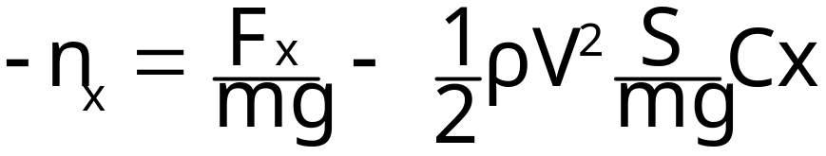
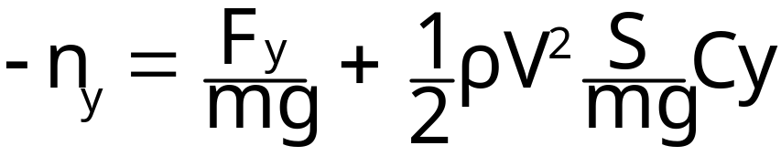
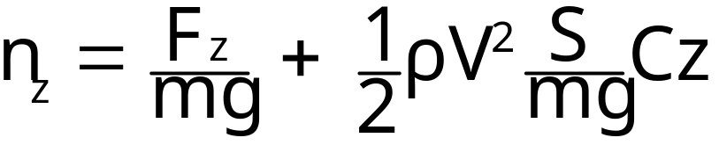
3. Load factor
Non dimensional form of forces equations
Propulsion contribution
proportional to thrust to weight ratio (F/mg)
Aerodynamics contribution
proportional to kinetic pressure, inversely proportional to wing loading
Notes:
This non-dimensional form of forces equations allows to underscore the importance of two parameters :
Thrust to weight ratio, which expresses the importance of thrust relative to the aircraft weight. Thrust to weight ratio may greater than 1, in the case of a fighter at combat weight.
Wing loading which expresses the weight per unit wing area. Since the aerodynamic forces are proportional to kinetic pressure and inversely proportional to wing loading, it is possible to state a simple rule : slow airplanes have low wing loadings and fast airplanes have high wing loadings.

Slide 20
4. Normal load factor limitations
Structural load factor limitations (n_{z1})
  Transport A/C (JAR/FAR 25) : + 2.5
  (+2.0 flaps or slats extended).
Lift limitation
  From lift equation : n_{z} mg = ½ ρV2SCz
  At given speed and altitude, maximum load factor obtained for Cz_{max}
Propulsion limitation
  For sustained load factors at constant speed and altitude (steady turns), thrust must balance drag.
Notes:
III- <number>
Issue 1 – Feb 2011
III – Maneuvering performance
The structural load factor limitation defines the maximum value for the normal load factor in A/C reference system (n_{z1}). The corresponding value for the normal load factor in aerodynamic reference system is :
n_{z} = - sinα n_{x1} + cosα n_{z1}
Note : Assuming zero sideslip angle and thrust/drag equilibrium (n_{x} = 0), this expression becomes :
In the expression for the lift limitation, the normal thrust component is neglected.
Maximum instantaneous load factor is constrained by structural limitation and lift limitation : it corresponds to the lower of those two limitations.
However, to maintain a constant load factor at constant speed and altitude, thrust/drag equilibrium must also be taken into account.
Maximum sustained load factor corresponds to the lower value of the maximum instantaneous load factor and the propulsion limitation.

Slide 21
4. Normal load factor limitations
n_{z}
Cz
Structural
limitation
Lift
limitation
Czmax.
Propulsion
limitation
1
Cz(n_{z}=1)
Straight level flight
n_{z} mg = qSCz
Cx
F = qSCx
Fn
thrust
required
Fu
Max. thrust
available
Thrust F
Notes:
III- <number>
Issue 1 – Feb 2011
III – Maneuvering performance
This slide presents the normal load factor limitations relative to the drag polar.
According to lift equation (when normal thrust component is neglected), normal load factor is a function of weight and kinetic pressure :
n_{z} mg = ½ ρ S V² Cz
For given flight conditions (A/C weight, airspeed, altitude and temperature), normal load factor is proportional to lift coefficient. Lift limitation corresponds to the maximum lift coefficient, it may be greater or lower than the structural limitation.
Maximum thrust, noted Fu, is a function of flight conditions (altitude, airspeed, temperature). It corresponds to a value for drag coefficient above which drag will be greater than thrust, noted Cxu :
Fu = ½ ρ S V² Cxu
On the drag polar, the lift coefficient corresponding to Cxu is noted Czu. The normal load factor corresponding to Czu defines the propulsion limitation : maximum normal load factor for which thrust/drag equilibrium can be achieved.

Slide 22
5. Low altitude flight envelope
Lift limitation
incompressible domain (low speed and altitude)
At low Mach numbers : Czmax constant
  Kc ≅ 1 ⇒ EV =Vc
  (equivalent airspeed equals calibrated airspeed)
Stall speed in straight horizontal flight (n_{z} = 1):
  mg = ½ ρ₀Vs_{1g}² S Cz_{max}
Maximum load factor at calibrated airspeed Vc :
  n_{zmax} mg = ½ ρ₀ Vc² S Czmax
  n_{zmax} = (Vc/Vs_{1g})²
Notes:
III- <number>
Issue 1 – Feb 2011
III – Maneuvering performance
In the incompressible domain, the maximum lift coefficient does not depend on Mach number. This is usually the case at low speeds and low altitudes.
In this domain, compressibility coefficient is close to 1 and, therefore, equivalent airspeed may be approximated by calibrated airspeed :
½ ρ V² = ½ ρ₀ EV² ≅ ½ ρ₀ Vc²
So, lift equation at stall speed may be used to express the lift limitation as a function of the ratio between actual calibrated airspeed and Vs_{1g}.
Vs_{1g} is the calibrated airspeed at stall under normal load factor equal to 1 (steady horizontal flight).
Note : This is no longer valid if the maximum lift coefficient is a function of Mach number, since the maximum lift coefficient Czmax will not have the same value at Vs_{1g} and at higher speeds.

Slide 23
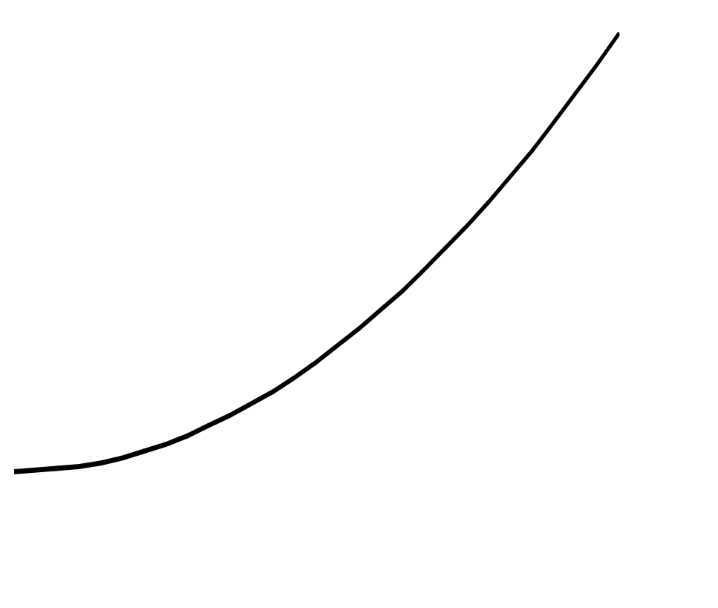
5. Low altitude flight envelope
Lift and structural limitations at low altitude
Load factor is limited by lift at low speeds and
by structural limitation at high speeds
Normal load
factor
n_{z}
Structural limitation
Lift
limitation
1
0
Vs_{1g}
Equivalent Airspeed
EV
Notes:
III- <number>
Issue 1 – Feb 2011
III – Maneuvering performance
This slide presents the lift and structural limitations for the normal load factor, in the case of an incompressible drag polar.
The lift limitation is proportional to the square of equivalent airspeed : it is equal to 1 for Vs_{1g}.
At higher speeds, normal load factor is limited by structural limitation.

Slide 24
5. Low altitude flight envelope
Stall speeds : Vs_{min} and Vs_{1g} (IAS)
  Vs_{min} : minimum indicated airspeed demonstrated during a stall maneuver.
  FAR/CS 25 : Deceleration from 1.3 Vs at no more than 1 kt/s, idle power at thrust.
  Vs_{1g} : minimum speed for straight and level flight, computed from flight test data (stalls).
  On average : Vsmin = 0.94 Vs1g.
Stall speeds are proportional to √m.
Notes:
III- <number>
Issue 1 – Feb 2011
III – Maneuvering performance
The stall speed, Vs, is defined as an Indicated Airspeed (close to CAS).
There are two definitions for Vs :
Vs_{min} is the demonstrated stall speed. It is the minimum speed demonstrated during a stall maneuver according to airworthiness regulations. According to FAR/CS 25, starting in straight and level flight at speed close to 1.3 Vs, power/thrust should be reduced to idle and deceleration should be kept close to 1 kt /s.
Vs_{1g} corresponds to the maximum lift coefficient :
mg = ½ ρ₀ S Vs_{1g}² Czmax
Airworthiness regulations (FAR/CS 25) allow to use one definition or another using a 0.94 average ratio between Vs_{min} and Vs_{1g}.
It must be noticed that Vs_{1g} demonstration for is more complex that Vs_{min} demonstration. The same stall maneuver must be performed, but the Czmax computation requires more data processing to compute parameters such as normal load factor in aerodynamic reference system.
Stall speeds are proportional to the square root of mass (lift equation).
Due to compressibility effects, maximum lift coefficient decreases when Mach number increases. As a consequence, stall speed increases when altitude increases (cf. chapter dedicated to maneuvering performance).

Slide 25
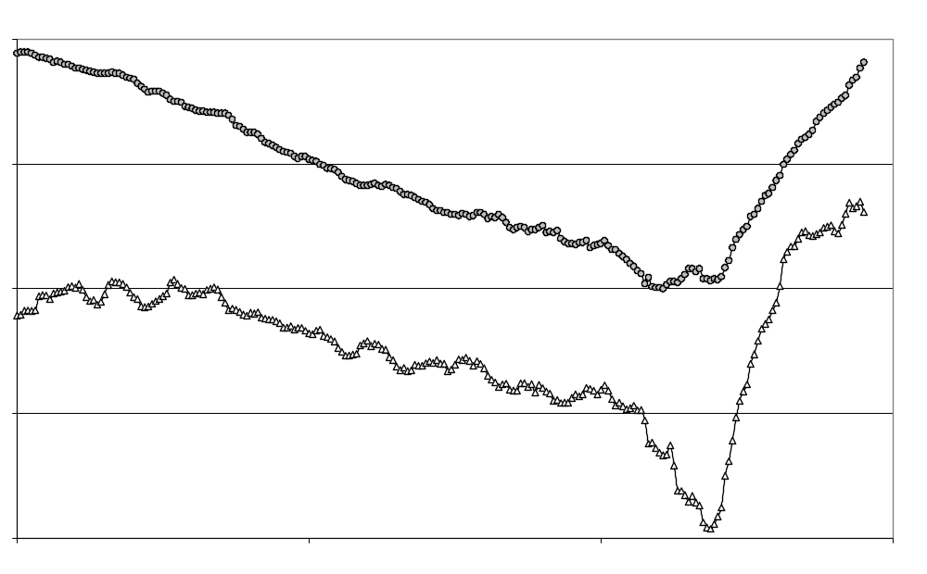
5. Low altitude flight envelope
Flight test data : Stall demonstration on TB20 light airplane
1.4
Vc/Vs_{min}
stall
1.2
n_{z}
1.0
0.8
0.6
0
10
20
30
Time (seconds)
Notes:
III- <number>
Issue 1 – Feb 2011
III – Maneuvering performance
This slide presents indicated airspeed and normal load factor evolutions with time, during a stall demonstration in a TB20 light single engine airplane.
For convenience, Vc/Vs_{min} is presented, instead of Vc in knots. Deceleration rate to Vs_{min} is approximately constant and normal load factor begin to decrease under 1, below 1.3 Vs_{min}. At stall, there is sharp decrease in the load factor.
In this case, the Vs_{min}/Vs_{1g} ratio is approximately 0.9 (square root of 0.8, load factor value at Vs_{min}).

